Slide 1
Reverse Outline for Nalo Hopkinson’s ”How to Write Descriptively”
BTW 250, OL3, Summer 2022
Video: https://ed.ted.com/lessons/how-to-write-fiction-that-comes-alive-nalo-hopkinson#watch

Slide 2
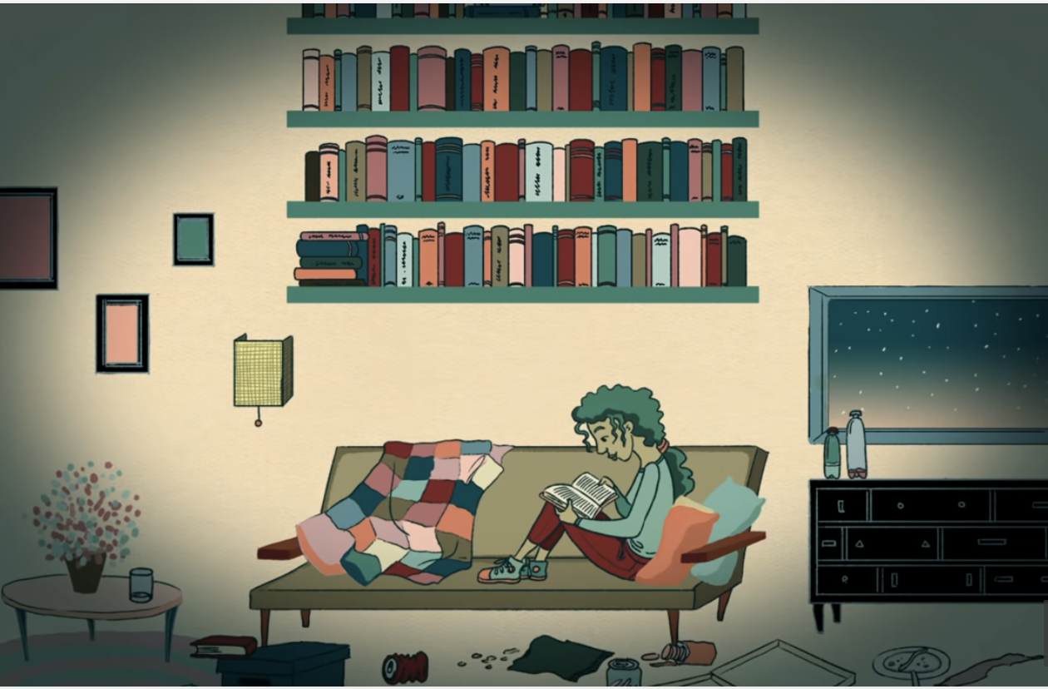
00:00 - 00:27
Information: Why do this thing?
Expressions: nostalgia/memory; list

Slide 3
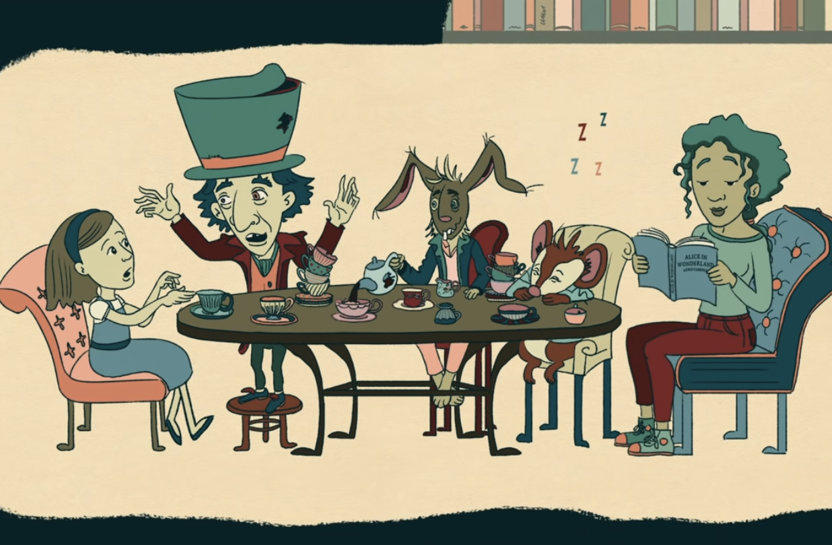
00:27 - 00:42
Information: How do you do this thing? (Overview)
Expressions: questions; using possible, familiar scenarios to set up a contrast

Slide 4
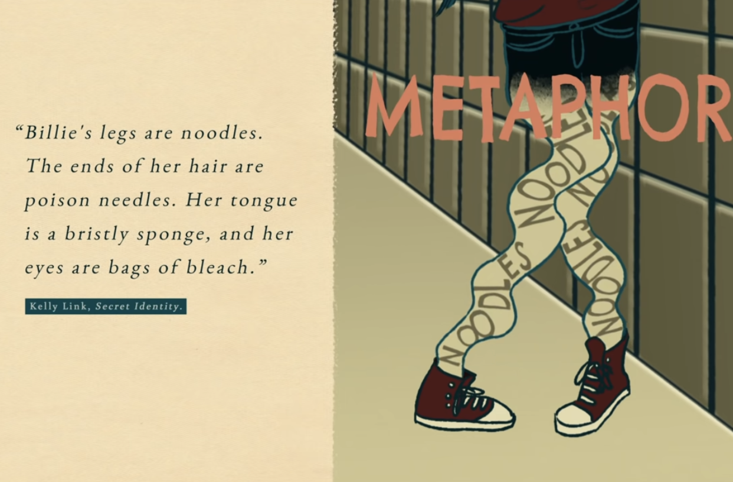
00:42 - 01:18
Information: How do you do this thing?
Expressions: good example > question > explanation > definition > bad example

Slide 5
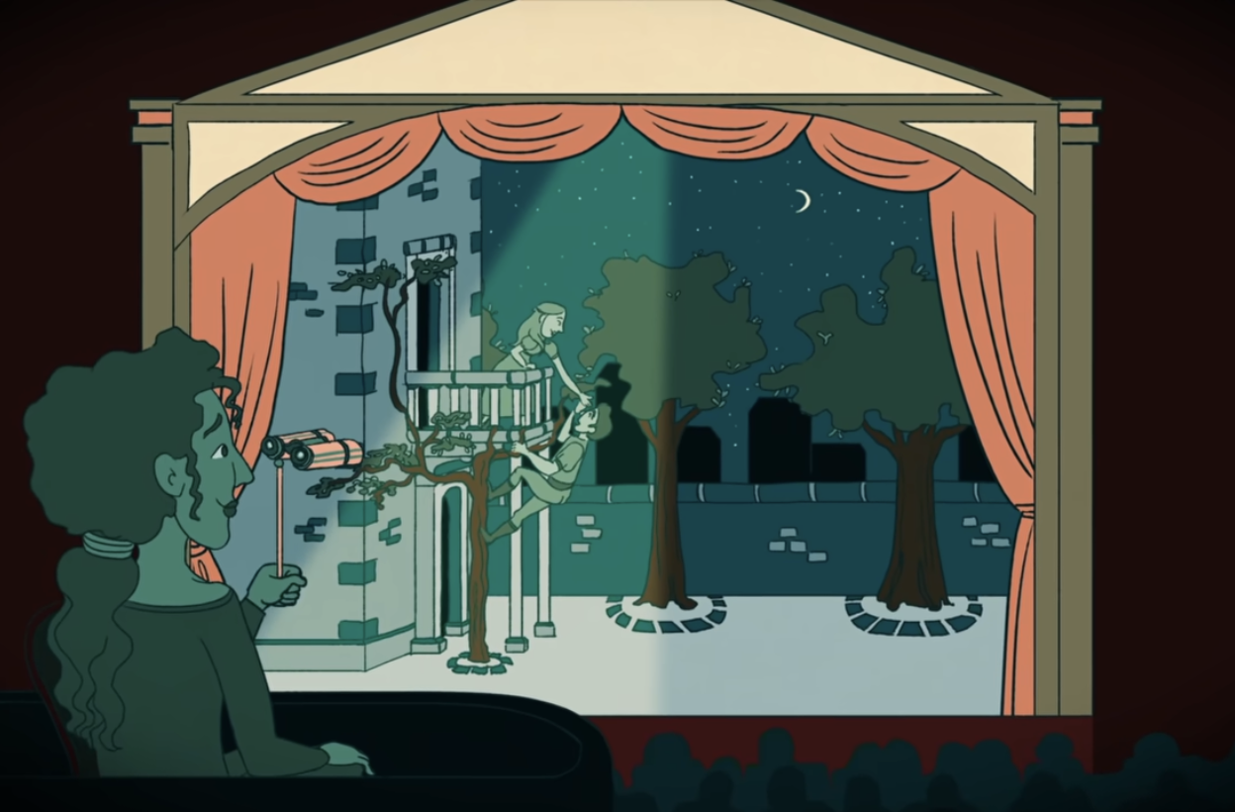
01:18 - 01:47
Information: What is this thing?
Expressions: comparison to similar thing (the stage); descriptions of each (i.e., “static symbols on a contrasting background)*
*note the reference to contrast and design here

Slide 6
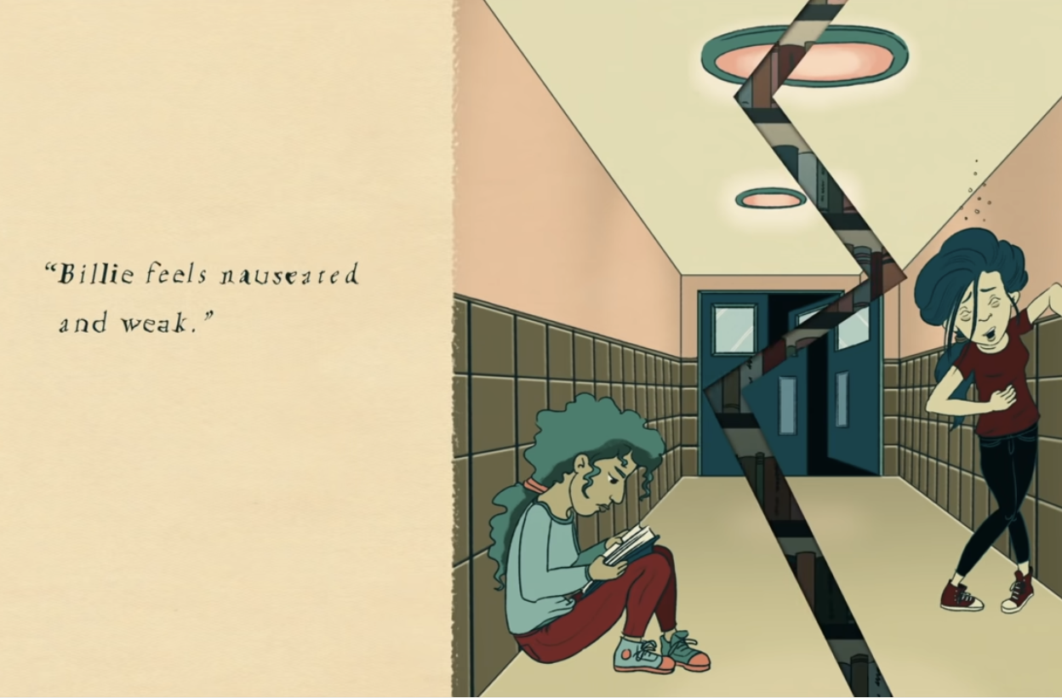
01:47 - 02:13
Information: limitations of this thing
Expressions: return to bad example; description of why it fails

Slide 7
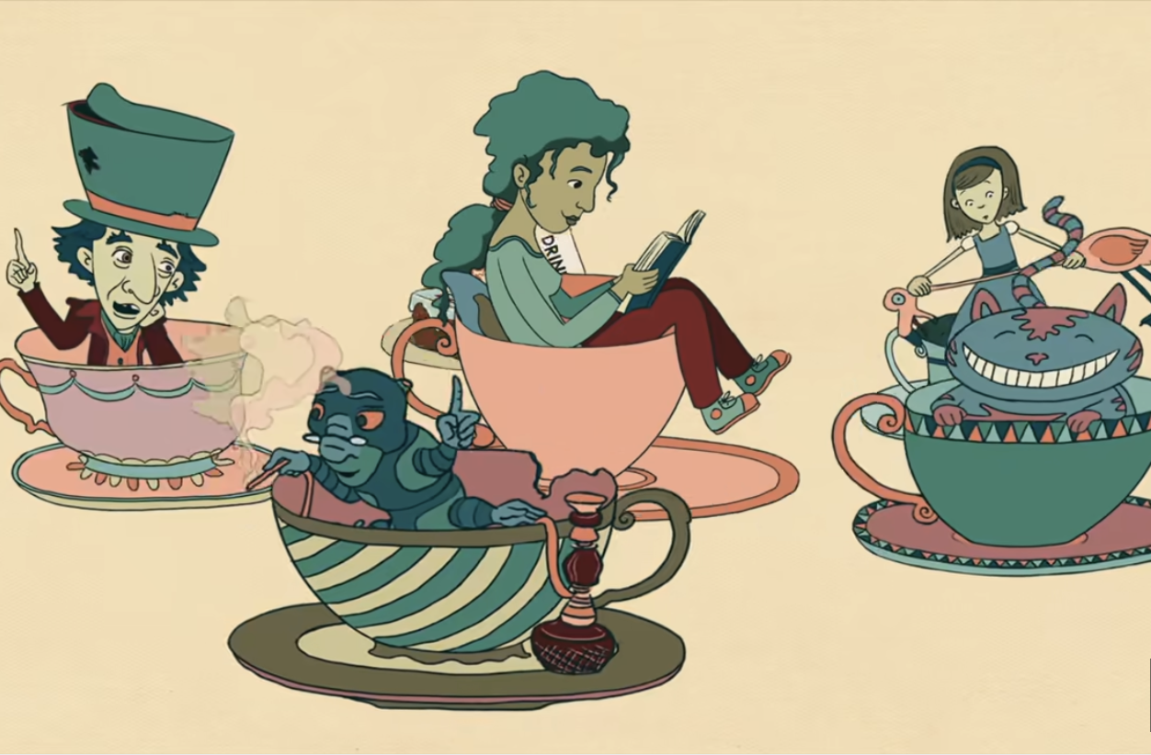
02:13 - 02:28
Information: What this thing does?
Expressions: informative statement with colon > list elaborating information > new idea that complicates information

Slide 8
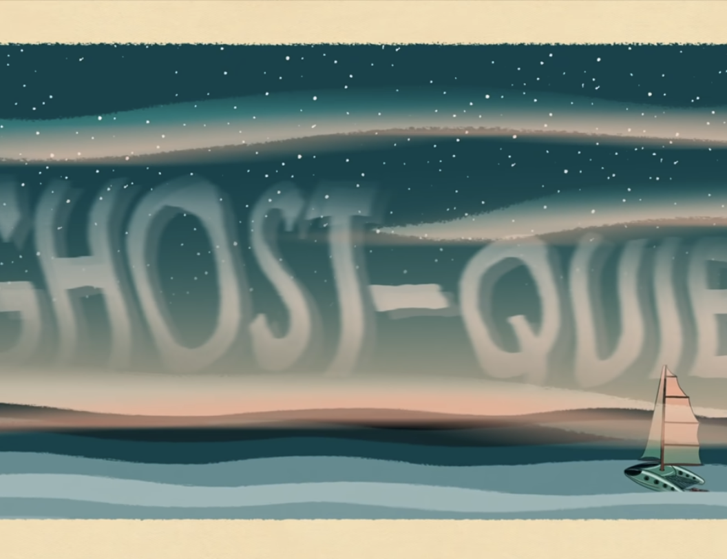
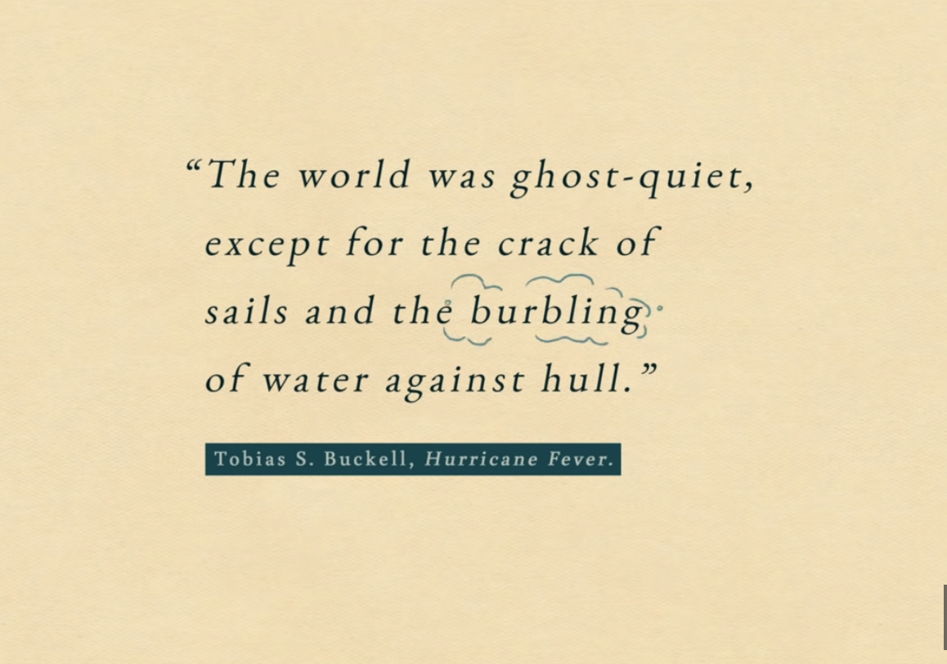
02:28 - 03:28
Information: What makes this thing work?
Expressions: new examples; interpretation; metaphor; description

Slide 9
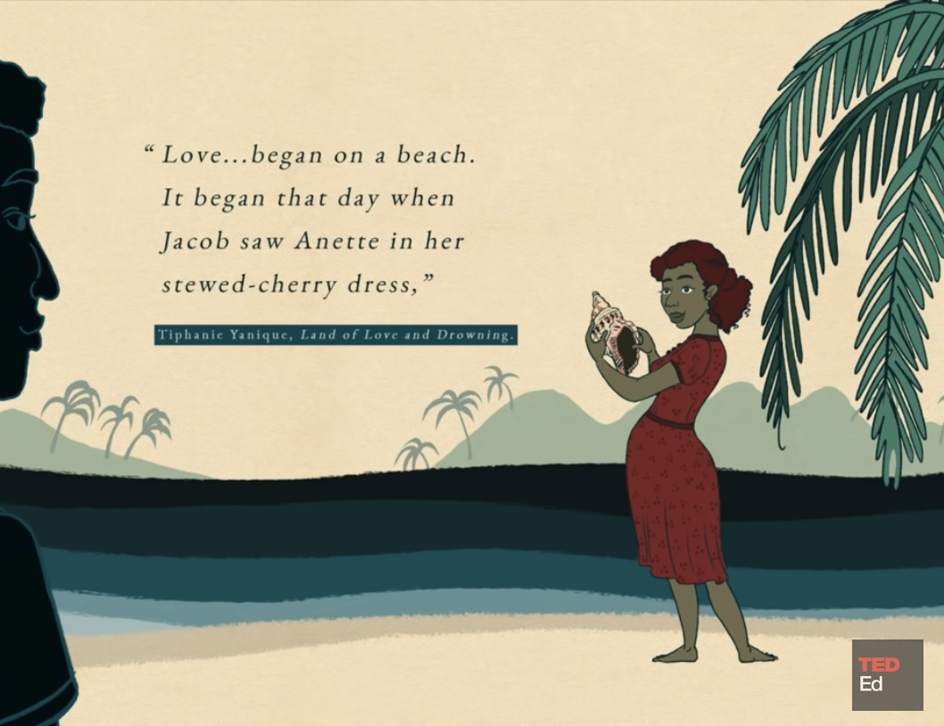
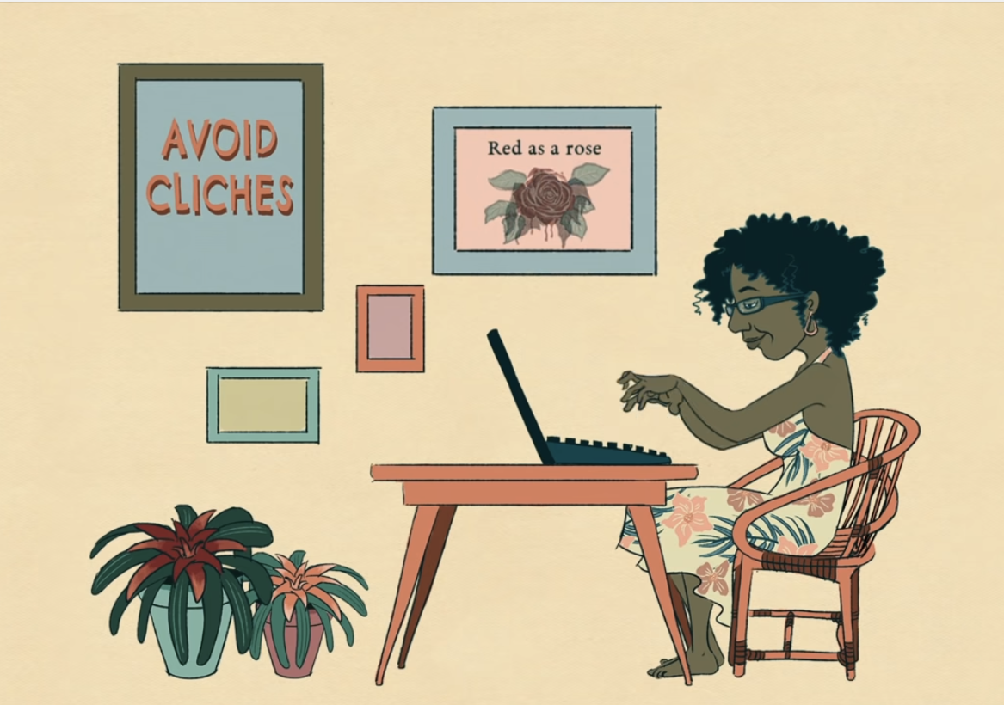
03:28 - 04:07
Information: What doesn’t work?
Expressions: subcategory of the larger topic (i.e., cliches); contrasting new example that does work; interpretation of why they are different, why the latter works

Slide 10
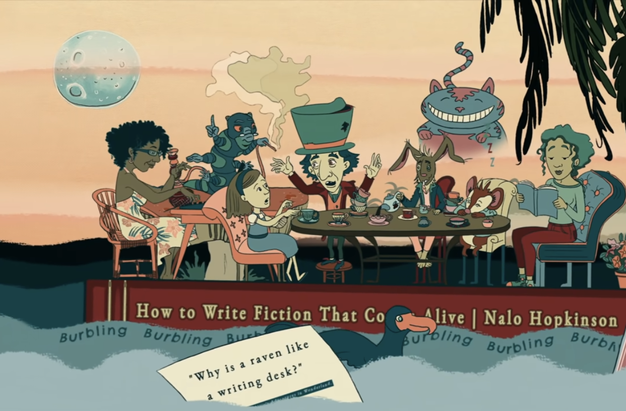
04:07 - 04:29
Information: final thoughts
Expressions: return to earlier lists; a list of steps to get started

Slide 11
As you begin your own reverse outline…
Notice the kinds of expressions we identified for Nalo Hopkinson. How are they different from content? Do you identify similar ones in your own examples?
There are perhaps thousands of other kinds of expressions. Which do you notice?
How can you follow Hopkinson’s instructions, as well as her expressions, in your own writing? Where could your manual benefit from more description?

